Slide 1
ETM Technologies

Slide 2

Shoot the ball v1

Slide 3

Shoot the ball
start

Slide 4


Level 1
Try again

Slide 5
Shoot the ball!
return

Slide 6

Yaaay!
let's move on to next level

Slide 7
Level 2
Try again

Slide 8
You did it again!
Let's move on

Slide 9
Level 3
Try again

Slide 10
Nice job!
What about cars?

Slide 11
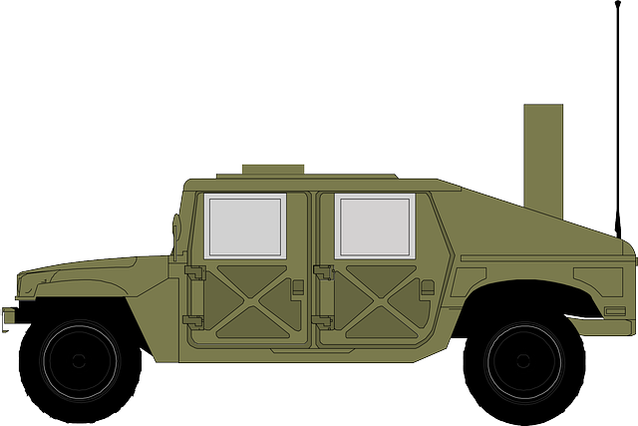

Level 4
Try again

Slide 12
Nice Shot

Slide 13
Level 5
Try again

Slide 14
More speed?

Slide 15
Level 6
Try again

Slide 16
Now shoot the rabbit!

Slide 17

Level 7
Try again

Slide 18
Shoot the rabbit!
return

Slide 19
Nice job
Now let's cook it

Slide 20
Level 8
Good job!
Now let's cook it

Slide 21

Level 8
Night
You are alone
You hear something
Good job!
Now let's cook it

Slide 22
Level 9
Good job!
Now let's cook it

Slide 23

Level 10
Good job!
Now let's cook it

Slide 24
You are DEAD

Slide 25
X
Thanks for playing

